Slide 1

Advanced Database Management
Group Project
Team Members
Sara AIJarrash, Jonathan Baird, Kelsey Jones, Matthew Webb

Slide 2
Mendelian Genetics
DNA testing service
Goals
Find relationships with people around world
Data available for universities
Notes:
Mendelian genetics is a facility that provides DNA testing services throughout the world. The facility has several outlets in different parts of the world. Its main purpose is to find relationships that people around the world have.

Slide 3
Purpose
Create a Database
Data analysis
Information
Patterns
Notes:
The goal of this project is to create a database for Mendelian genetics that will be used in data analysis, storage of information and studying information patterns.

Slide 4
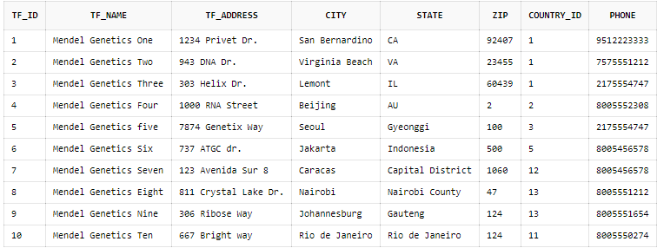
Tables
test_facility table
Notes:
The database contains the following tables, first, the test_facility table contains details of all the outlets of Mendelian genetics.

Slide 5
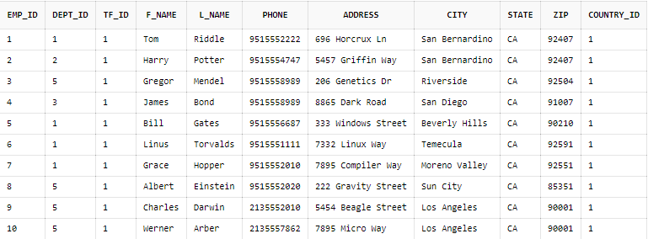
Tables
employee table
Notes:
The employee table contains details of all employees of Mendelian genetics and their outlet station.

Slide 6
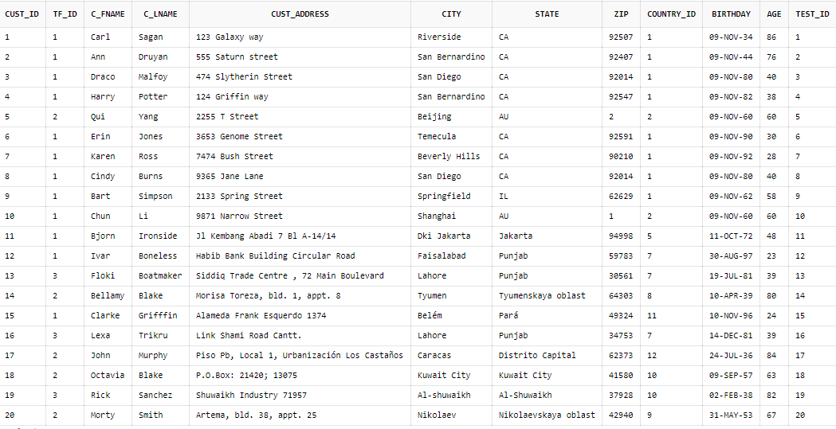
Tables
customer table
Notes:
The customer table contains the required personal information belonging to Mendelian genetics’ customers.

Slide 7
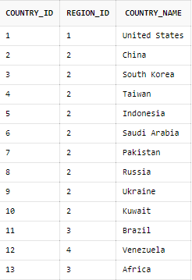
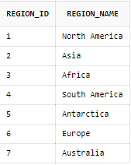
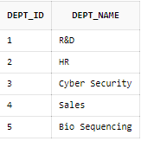
Tables
Country table
Region table
department table
Notes:
The department table contains details of the various departments at Mendelian genetics.
The country table shows Mendelian genetics outlets according to the country they are in.
The region table shows Mendelian genetics outlets according to the region they are in.

Slide 8
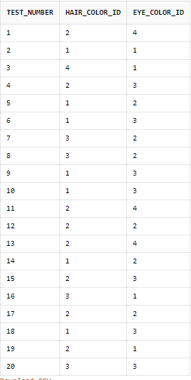
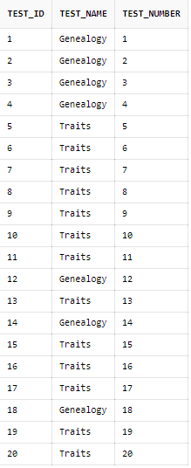
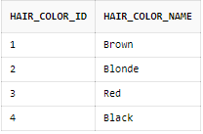
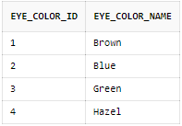
Tables
test_results table
test_type table
hair_color table
eye_color table
Notes:
The test_results stores results for the tests conducted denoted using test number, hair color and eye color IDs.
The test_type table stores information about the type of test to be conducted or conducted.
The hair_color table contains information hair color name and its ID.
The eye_color table contains information eye color name and its ID.

Slide 9
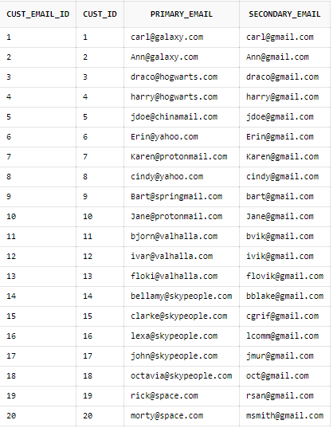
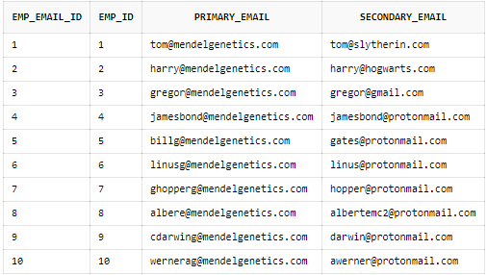
Tables
eustomer_email table
employee_email table
Notes:
The employee_email table stores information about employee primary and secondary emails.
The customer_email table stores information about customer primary and secondary emails.

Slide 10
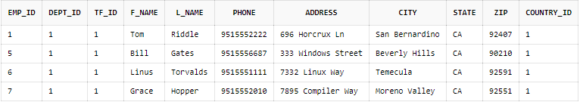
Questions
-- 1) Select all employees who work in a particular department
select * from employee minus select * from employee where not dept_id = 1;

Slide 11
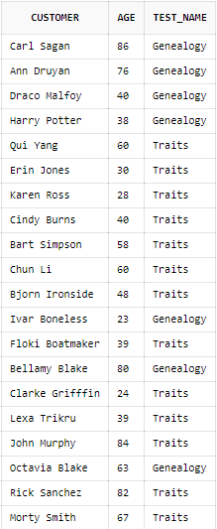
Questions
-- 2) Display customers, their age and test type
select CONCAT(CONCAT(c_fname, ' '), c_lname) as CUSTOMER, age, test_name from customer, test_type where customer.test_id = test_type.test_id;

Slide 12



Questions
-- 3) How many customers choose to have a Genealogy test?
select count(*) as "Number of Genealogy Tests Done" from(select * from test_type where test_name = 'Genealogy');
-- 4) How many customers choose to have a Traits test?
select count(*) as "Number of Traits Tests Done" from(select * from test_type where test_name = 'Traits');
-- 5) How many customers under the age of 40 had a test done?
select count(*) as "Customers under 40 that completed a test" from(select * from customer where age < 40);
om(select * from customer where age < 40);

Slide 13


Questions
-- 6) How many customers have brown hair?
select count(*) as "Customers with brown hair" from(select * from customer, test_type, test_results where customer.test_id = test_type.test_id and test_type.test_number = test_results.test_number and test_results.hair_color_id = 1);
-- 7) How many customers have blue eyes?
select count(*) as "Customers with blue eyes" from(select * from customer, test_type, test_results where customer.test_id = test_type.test_id and test_type.test_number = test_results.test_number and test_results.eye_color_id = 2);

Slide 14
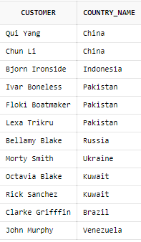
Questions
-- 8) List customers outside of the United States?
select CONCAT(CONCAT(c_fname, ' '), c_lname) as CUSTOMER, country_name from customer, country where not customer.country_id = 1 and customer.country_id = country.country_id;

Slide 15
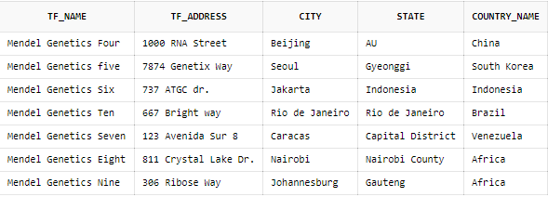
Questions
-- 9) List test facilities outside the united states.
select tf_name, tf_address, city, state, country_name from test_facility, country where not test_facility.country_id = 1 and test_facility.country_id = country.country_id;

Slide 16
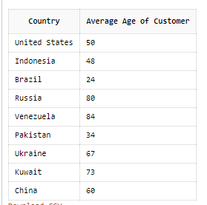
--10) Displays the average age of the customers by country.
SELECT country.country_name as "Country", CAST(AVG(age) as INT) as "Average Age of Customer"
FROM customer INNER JOIN country ON customer.country_id = country.country_id GROUP BY country_name;
Questions

Slide 17
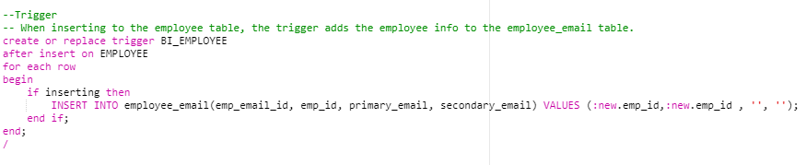
Trigger
This must happen after insert. Otherwise there will be an integrity violation.
Notes:
The trigger is invoked when the database user inserts data into the employee table. Meaning as data is inserted into employee table, some employee information is automatically added into the employee email table.

Slide 18
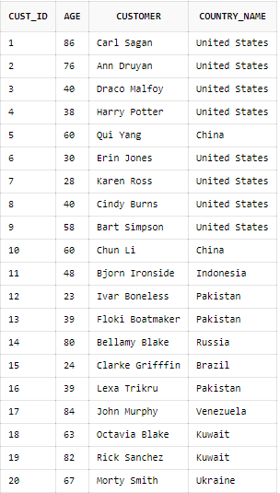
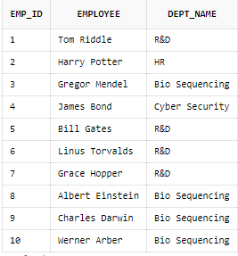
Views
View 2
View 1
Notes:
The EMPLOYEE_VW will be applied after the create view EMPLOYEE_VW statement is successfully executed, and to view it the select * from EMPLOYEE_VW will be executed.
The CUSTOMER_VW will be accessed after is created and the select statement is executed; create view CUSTOMER_VW then select * from CUSTOMER_VW.
In conclusion, this database project is well implemented, with all the required details having been put into consideration. It will enable Mendelian genetics meet its objective of providing DNA testing services throughout the world therefore, finding relationships that people around the world have.

